Slide 1

Classifying URLs A Machine Learning Approach
Milestone Report
Author: Helga Wilde

Slide 2
Outline
Background
Project Approach & Goals
Data
Feature Creation
Exploratory Data Analysis
Inferential Statistics

Slide 3
Background

Slide 4
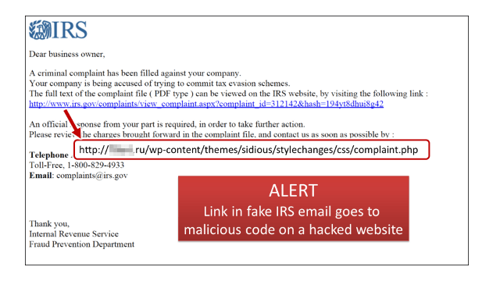
Malicious web content remains a key resource leveraged by threat actors

Slide 5
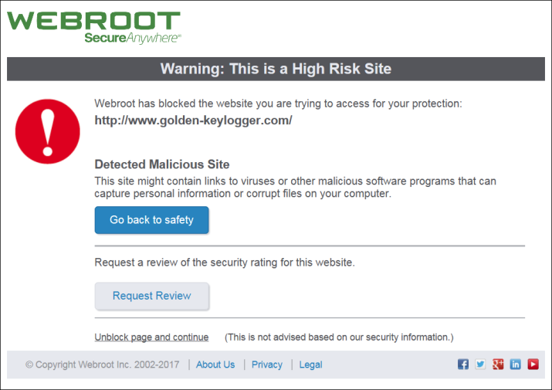
Identification of malicious urls
…a key capability for many security tools, using:
1. Black Lists
2. Real-Time Evaluation
URL source code
Client/server communication
Client system changes

Slide 6
Problems with URL identification
Heavy reliance on reputation lists
Threat actors may leverage legitimate websites
Rule-based detectors can’t keep up with changing tactics
Anti-forensic techniques may deter analysis

Slide 7
Machine Learning Techniques
Feature sets utilize one or more of the following:
URL-based (lexical)
Host-based
Reputation lists
Domain name registration
Domain name resolution
Connection speed
Link popularity
URL source code

Slide 8
Project Approach & Goals

Slide 9
Considerations
Risk in connecting to a potentially malicious web page
Ability to building out a full feature set for each url
Availability of url
Anti-forensic measures
Changing TTPs
Reputable sites may host malicious content
Link popularity may be low regardless of url class

Slide 10
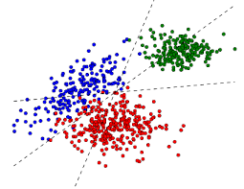
Goals
One multi-classification model which accurately classifies a url as benign, phishing or malicious
Self-reliant model >>>
lexical-based feature set
Understand feature importance
Utilize model in security operations workflows

Slide 11
Supervised Learning Techniques
Train model using the following datasets:
Feature set based on lexical features
Term-document matrix (NLP approach)

Slide 12
Data

Slide 13




Data Records
Benign URLs
25,000+ collected by crawling Alexa top 2500 websites
Reputation check via 70 antivirus scanners on VirusTotal.com
Phishing URLs
10,000 (sampled from 17,000+ urls from PhishTank)
Malicious URLs
10,000 (sampled from 600,000+ from abuse.ch URLHAUS project)

Slide 14
Feature Creation

Slide 15
What’s in a url?
https://data.example.com/info/aboutus/reserved=0?color=black&style=light#top
scheme netloc path params query fragment

Slide 16
Feature Creation
96 predictor features created from url and url-parsed strings
All numerical, with the exception of the list of token substrings
Include:
length
character composition
character location
entropy
masquerading
IP address
domains in Alexa top 500 list

Slide 17
Feature Creation cont.
Key feature descriptions:
list of all tokens – parsed elements of the url, each substring of same character type
e.g. www, ., google, ., com
entropy – a Shannon entropy score reflecting the string’s character distribution.
character continuity rate – reflects total length of each alphabetic, digit and special character strings, divided by length of url

Slide 18
Feature Creation cont.
number of masques – count of letter + digit + letter combinations
percent of uppercase / percent of lowercase letters – reflects the percent of these characters against all alphabet characters in given string
is domain in Alexa top 500? – each domain was checked against the current Alexa top 500 website list.

Slide 19
Exploratory Data Analysis

Slide 20
Malicious URLs – Key Findings
Approximately 50% of the urls in our dataset have an IP address in lieu of a domain
Urls are shorter on average (44.9 characters) than benign (57.4) or phishing (89.1) and have shorter token lengths (3.0 versus 3.4 and 4.1)
On average, these urls have the highest entropy score, 1.072, in comparison to phishing urls (.778) and benign (.576)
Example urls (altered for safety):
hxxp[:]//48.218.61.11:33553/Moxi.m
hxxps[:]//pastebin.com/raw/7MjG2xsJ
hxxp[:]//www.formations-manox.org/fr/wp-admin/Scan/

Slide 21
Phishing URLs – Key Findings
Phishing urls have the longest urls on average, the longest netloc and domain sections. Also the most likely to have one or more subdomains
The urls have a greater percentage of special characters (29.3% versus 16.2 and 23.2% for malicious and benign urls)
Path sections are on average slightly shorter than benign urls and have a greater propensity for single character paths
Path sections have on average a higher number of masques (.468 versus .257 and .109)
Example url (altered for safety):
hxxp[:]//store.ebay.de.roomyb.com/?ebay.de/signin&amp;usingssl=1&amp;puserid=&amp;co_partnerid=2&amp;siteid=77&amp;ru=https:/contact.ebay.be/ws/ebayisapi.dll?m2mcontact&amp;item=164305393996&amp;ul_noapp=true&amp;self=howill99&amp;redirect=0&amp;qid=273594504301

Slide 22
Inferential Statistics

Slide 23
Inferential Statistics
Pairwise Correlation Analysis
a significant number of highly correlated features
73 pairs of features have correlation scores of 80+%
Predictor v Target Correlation Analysis
Numeric-based domain and netloc features most highly correlated with target feature
May be reflective of IP addresses in malicious urls

Slide 24
Next Steps

Slide 25
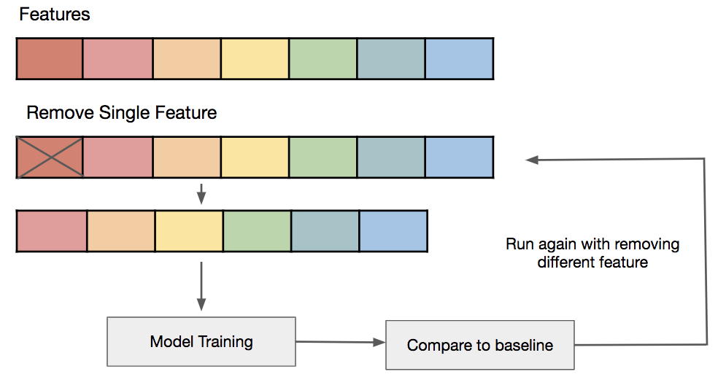
Feature Selection
Utilize pairwise feature correlation scores to tailor feature set
Goal is an independent feature set
Additional changes may be made during model training, to improve accuracy scores

Slide 26
Build and test machine learning models
Lexical Feature Set
URL Tokens
Prep
Finalize lexical feature set
Remove categorical features
Train
Parameter/Classifier tuning
Test
Predict on test data
Analyze scores
Analyze scores
Prep
Tokenization
Build Term-document matrix
Train
Parameter/Classifier tuning
Analyze scores
Test
Predict on test data
Analyze scores

Slide 27
The End

